Slide 1
e-Fonty
Security Programming
-
Radu Alexandru, Raditya Surya Pratama, Georgiana Manolache, Armin Roushan, Jan-Niklas Schneider, Nina O’Driscoll

Slide 2
Security breaches have been increasing considerably over the last decade, becoming an everyday problem for both low and high-profile organizations.

Slide 3
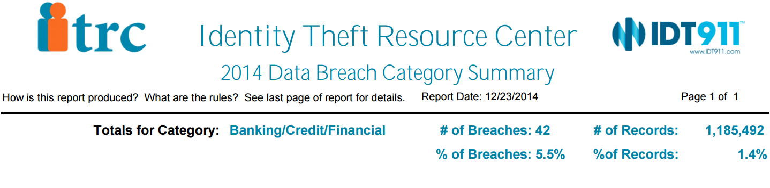
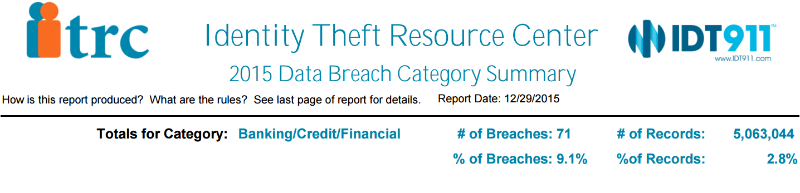
Banking breaches Summary 2014-2015

Slide 4
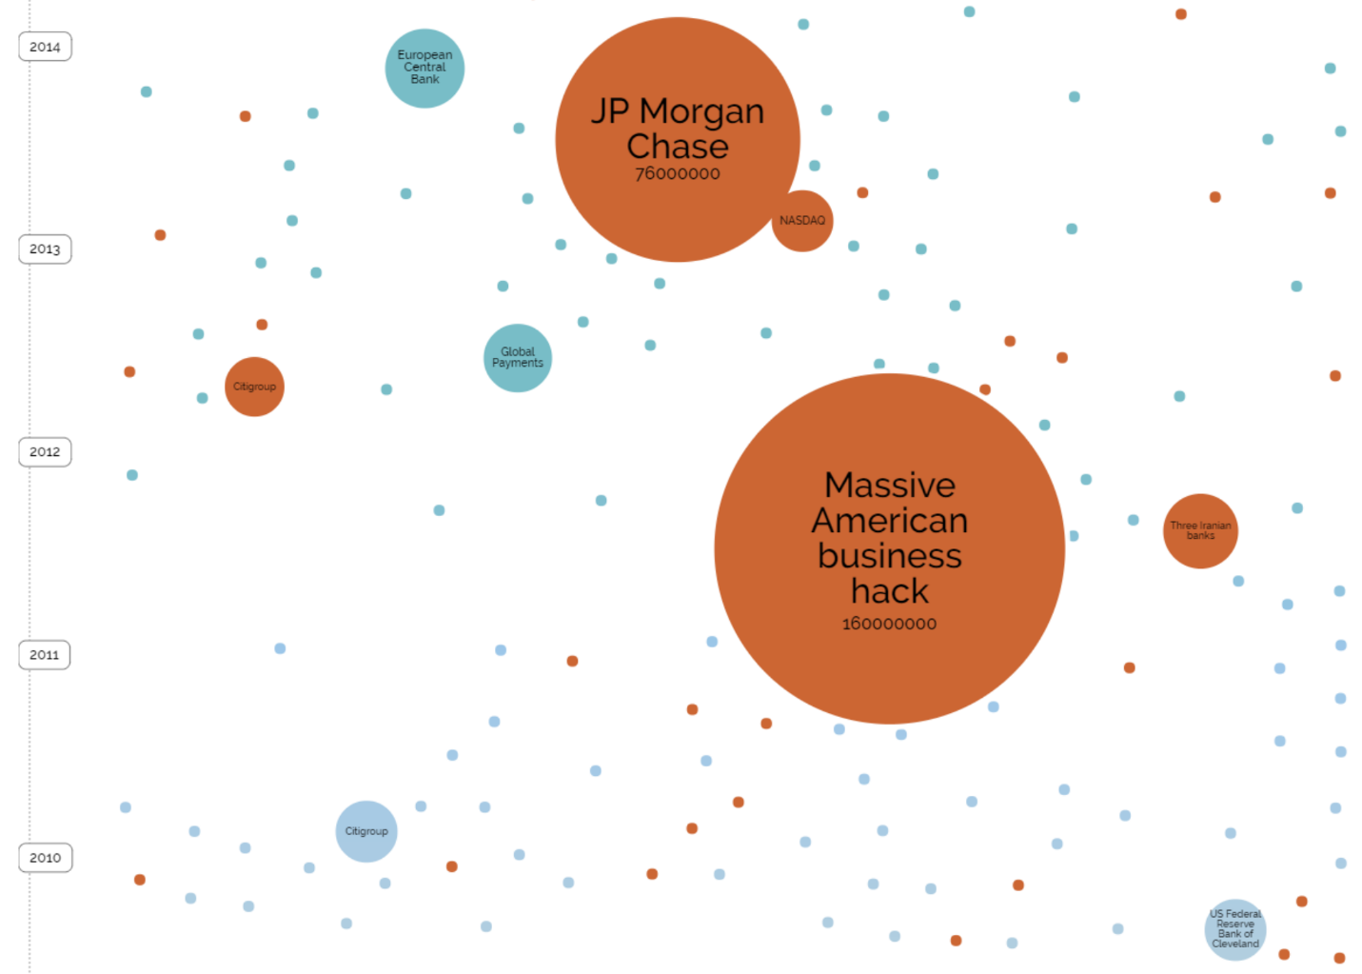
Notes:
Among the affected financial services organizations there is JP Morgan Chase, European Central Bank, US Federal Reserve Bank of Cleveland, Citigroup

